Slide 1

Project Title -Seasonal Agriculture Performance Analysis
[ Student Name: Potu Goutham College Name- Anurag University ]
AICTE STU ID : (STU66349b7abdc391714723706)

Slide 2

Problem Statement
Agricultural activities are influenced by seasonal variations in environmental conditions, farming practices, resource availability and market conditions. As a result, agricultural performance may differ from one season to another.
However, raw agricultural data does not clearly explain how agricultural performance changes across seasons or what patterns can be observed in different seasonal conditions.
The problem is to analyze the given agricultural dataset and investigate seasonal differences in agricultural performance by identifying meaningful patterns, trends, relationships and variations within the available data.
VOIS × AICTE | Major Project | Seasonal Agriculture Performance Analysis

Slide 3
Project Description
DATA SCOPE
VARIABLES
SEASONS
CROPS
4,000
28
3
8
Farm-level records
Environment • resources • economics
Kharif • Rabi • Zaid
Multiple crop categories
Dataset covers farm location, crop and season, environmental conditions, soil characteristics, inputs, irrigation, yield, production, market price and financial outcomes.
Analysis follows a focused seasonal-performance approach rather than a generic whole-dataset exploration.
Workflow: data audit → cleaning → exploratory analysis → seasonal comparison → statistical testing → interpretation → recommendations.
Missing data: 120 cells across Rainfall, Soil Moisture and Yield; handled with season-wise median imputation. No duplicate rows detected.
VOIS × AICTE | Major Project | Seasonal Agriculture Performance Analysis

Slide 4

Who Are the End Users?
FARMERS
AGRICULTURAL PLANNERS
AGRIBUSINESS
Season planning
Evidence-based decisions
Economic planning
Compare expected performance and resource patterns across seasons.
Use seasonal trends to prioritize interventions and resources.
Understand revenue, cost and profit variation by season.
RESEARCHERS
POLICY / EXTENSION TEAMS
Further investigation
Targeted support
Use observed relationships to frame deeper agronomic studies.
Identify seasonal risk and resource-use areas needing attention.
The analysis is intended as decision support—not as a substitute for local agronomic or market expertise.
VOIS × AICTE | Major Project | Seasonal Agriculture Performance Analysis

Slide 5

Technology Used
Python
Pandas
NumPy
Matplotlib
Core analysis
Data preparation
Numerical work
Visualization
Data processing and statistical analysis
Cleaning, grouping, aggregation and reshaping
Numerical transformations and calculations
Professional analytical charts
SciPy
Jupyter / Colab
PowerPoint
Statistics
Development
Communication
ANOVA, Kruskal–Wallis and Mann–Whitney U tests
Reproducible notebook workflow
Executive presentation of findings
Analytical approach: descriptive statistics + comparative analysis + visualization + non-parametric and parametric statistical testing.
VOIS × AICTE | Major Project | Seasonal Agriculture Performance Analysis

Slide 6
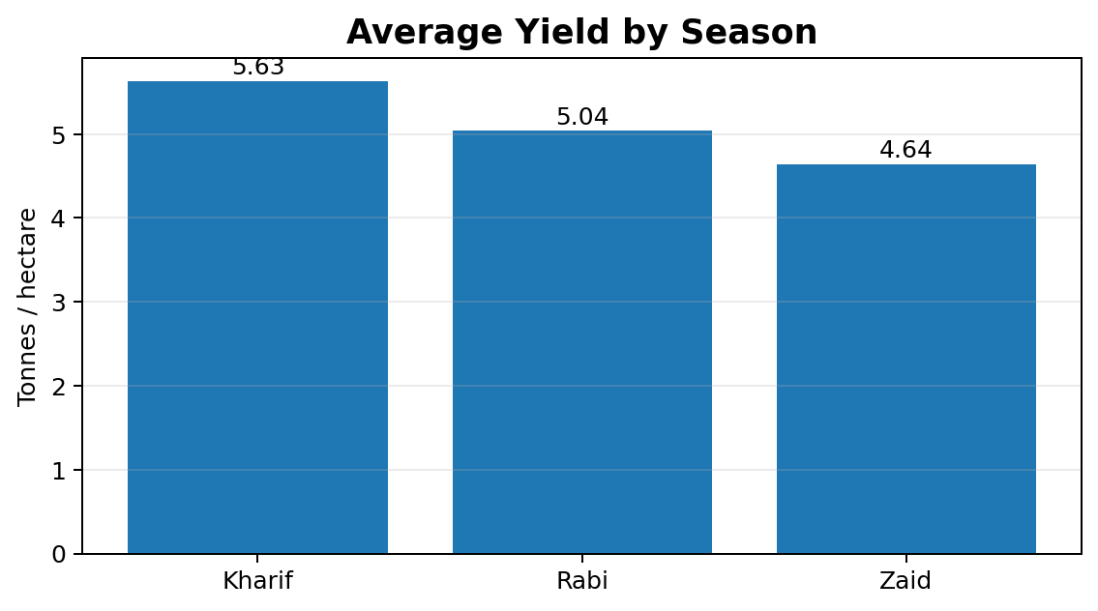
Results | Seasonal Yield Performance
HIGHEST AVERAGE YIELD
Kharif
5.63 t/ha
LOWEST AVERAGE YIELD
Zaid
4.64 t/ha
MEDIAN YIELD
Kharif
1.95 t/ha
Interpretation: Kharif has the highest mean and median yield among the three seasons, while Zaid has the lowest.
VOIS × AICTE | Major Project | Seasonal Agriculture Performance Analysis

Slide 7
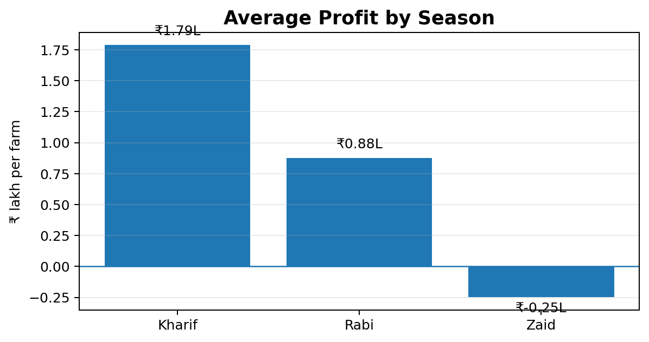
Results | Economic Performance
KHARIF PROFIT
₹1.79L
Highest average profit
RABI PROFIT
₹0.88L
Positive average profit
ZAID PROFIT
−₹0.25L
Average loss
Profitable-farm share: Kharif 57.8% • Rabi 48.9% • Zaid 35.5%
VOIS × AICTE | Major Project | Seasonal Agriculture Performance Analysis

Slide 8
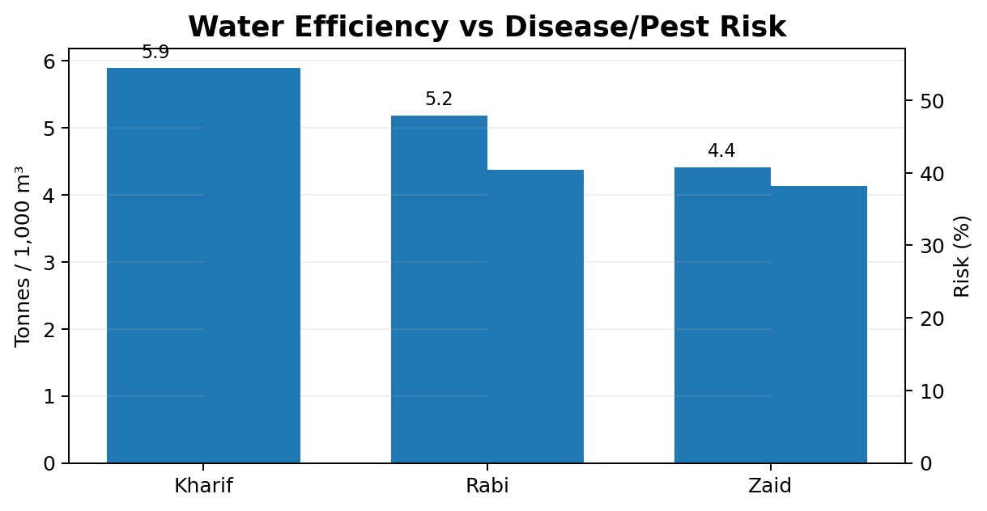
Results | Resource Use & Risk
BEST WATER EFFICIENCY
Kharif
5.89 t/1,000 m³
HIGHEST WATER USE
Zaid
6420 m³
HIGHEST RISK
Kharif
54.5%
Kharif combines strong yield and water-efficiency averages but also shows the highest disease/pest risk.
VOIS × AICTE | Major Project | Seasonal Agriculture Performance Analysis

Slide 9
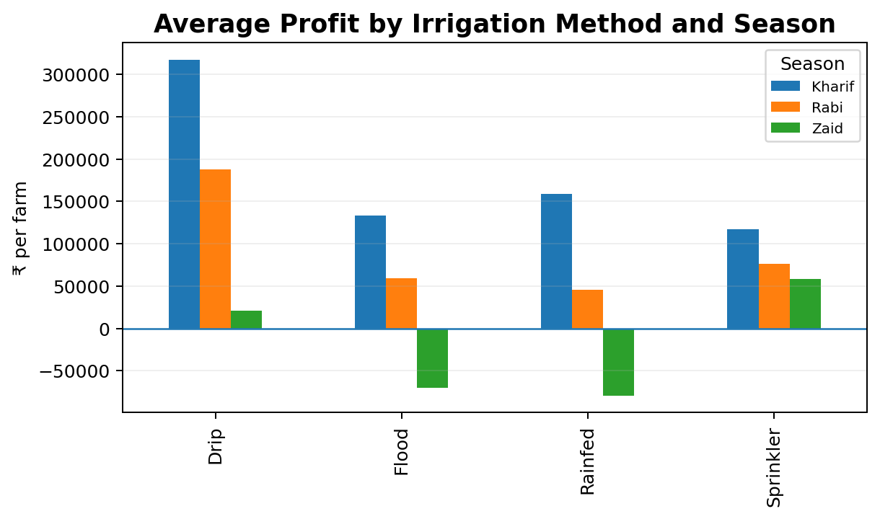
Results | Irrigation Comparison
KHARIF
Drip
Highest average profit in season
RABI
Drip
Highest average profit in season
ZAID
Sprinkler
Highest average profit in season
Across the dataset, irrigation method is associated with substantial differences in profit and water use; these are associations, not causal proof.
VOIS × AICTE | Major Project | Seasonal Agriculture Performance Analysis

Slide 10
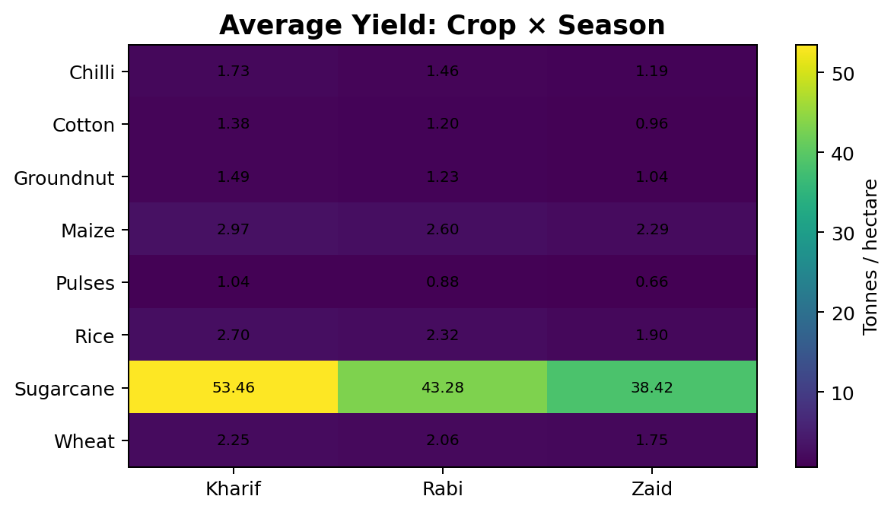
Results | Crop × Season & Statistical Evidence
STATISTICAL TESTS
ANOVA: F = 1.55, p = 0.212
Kruskal–Wallis: H = 70.17, p < 0.001
Effect size (η²): 0.0008
All three pairwise Mann–Whitney U comparisons remain significant after Bonferroni correction (α = 0.05).
KEY INTERPRETATION
Seasonal yield distributions differ significantly under the non-parametric test.
The very small η² indicates season alone explains little of total yield variance.
Therefore, seasonal differences should be interpreted alongside crop, environment, inputs and farm characteristics.
VOIS × AICTE | Major Project | Seasonal Agriculture Performance Analysis

Slide 11
Future Scope
Build predictive models for yield, profit and disease/pest risk by season.
Add multi-year time-series data to separate seasonal effects from year-to-year variation.
Incorporate local weather forecasts, soil-test data and market-price forecasts.
Develop crop-specific and region-specific recommendation models.
Evaluate irrigation and input strategies with causal or experimental designs.
Create an interactive dashboard for farmers, planners and agribusiness users.
Add explainable AI techniques to make predictive recommendations easier to trust.
VOIS × AICTE | Major Project | Seasonal Agriculture Performance Analysis

Slide 12
GitHub Link
[https://github.com/gouthampotu/Seasonal-Agriculture-Performance-Analysis.git ]
VOIS × AICTE | Major Project | Seasonal Agriculture Performance Analysis

Slide 13

VOIS Course completion certificate -
Course name- Data Visualization

Slide 14
Thank You

